Slide 1
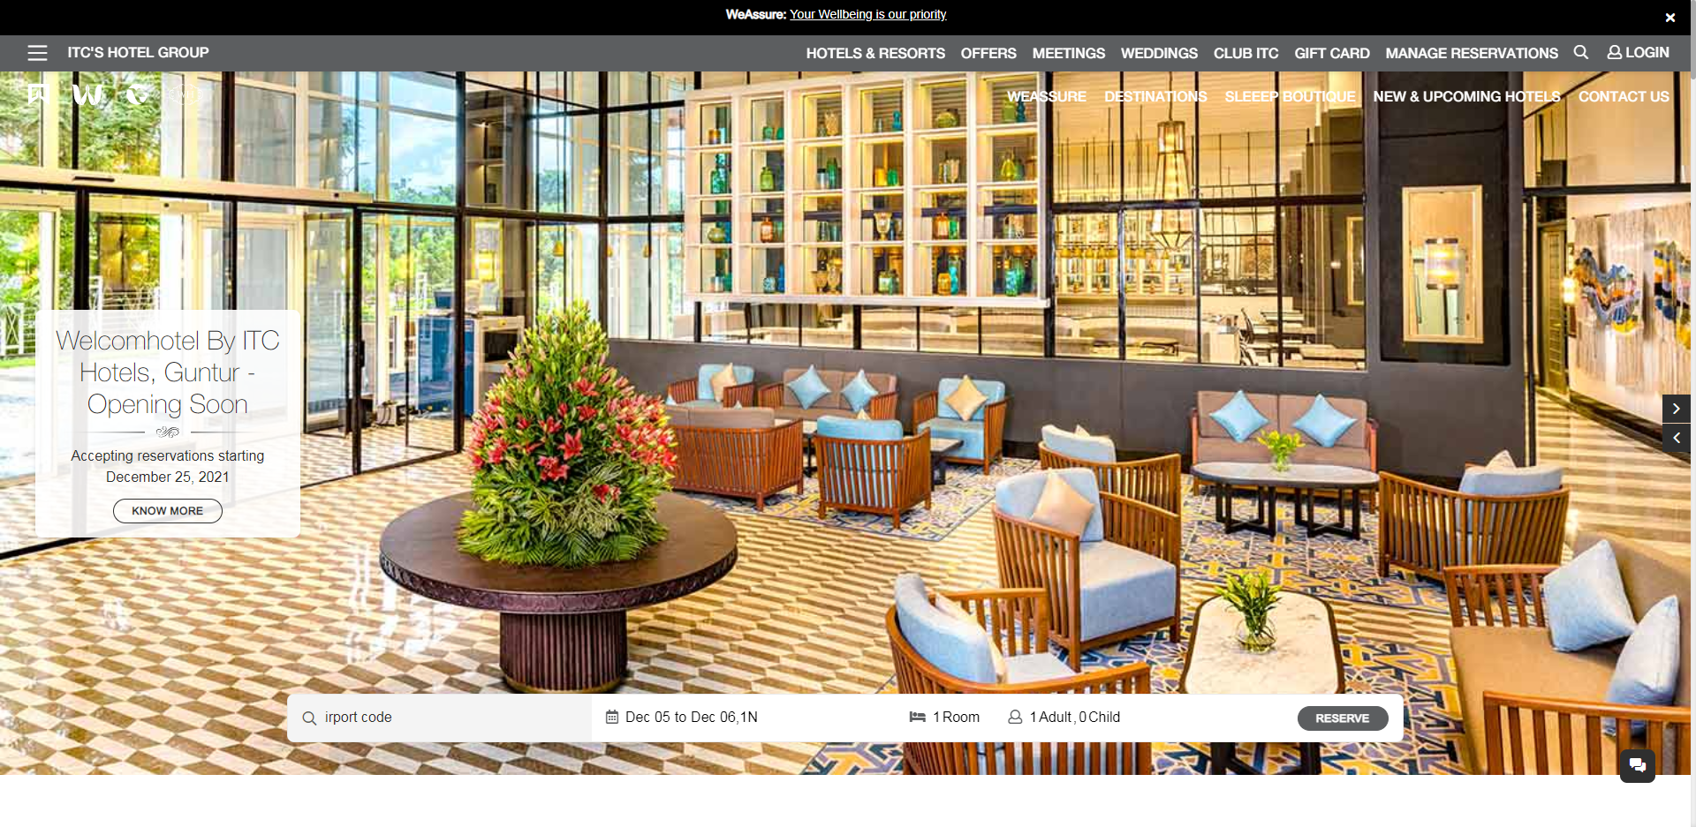
Home Page, add little bit transparency effect in the carousel

Slide 2
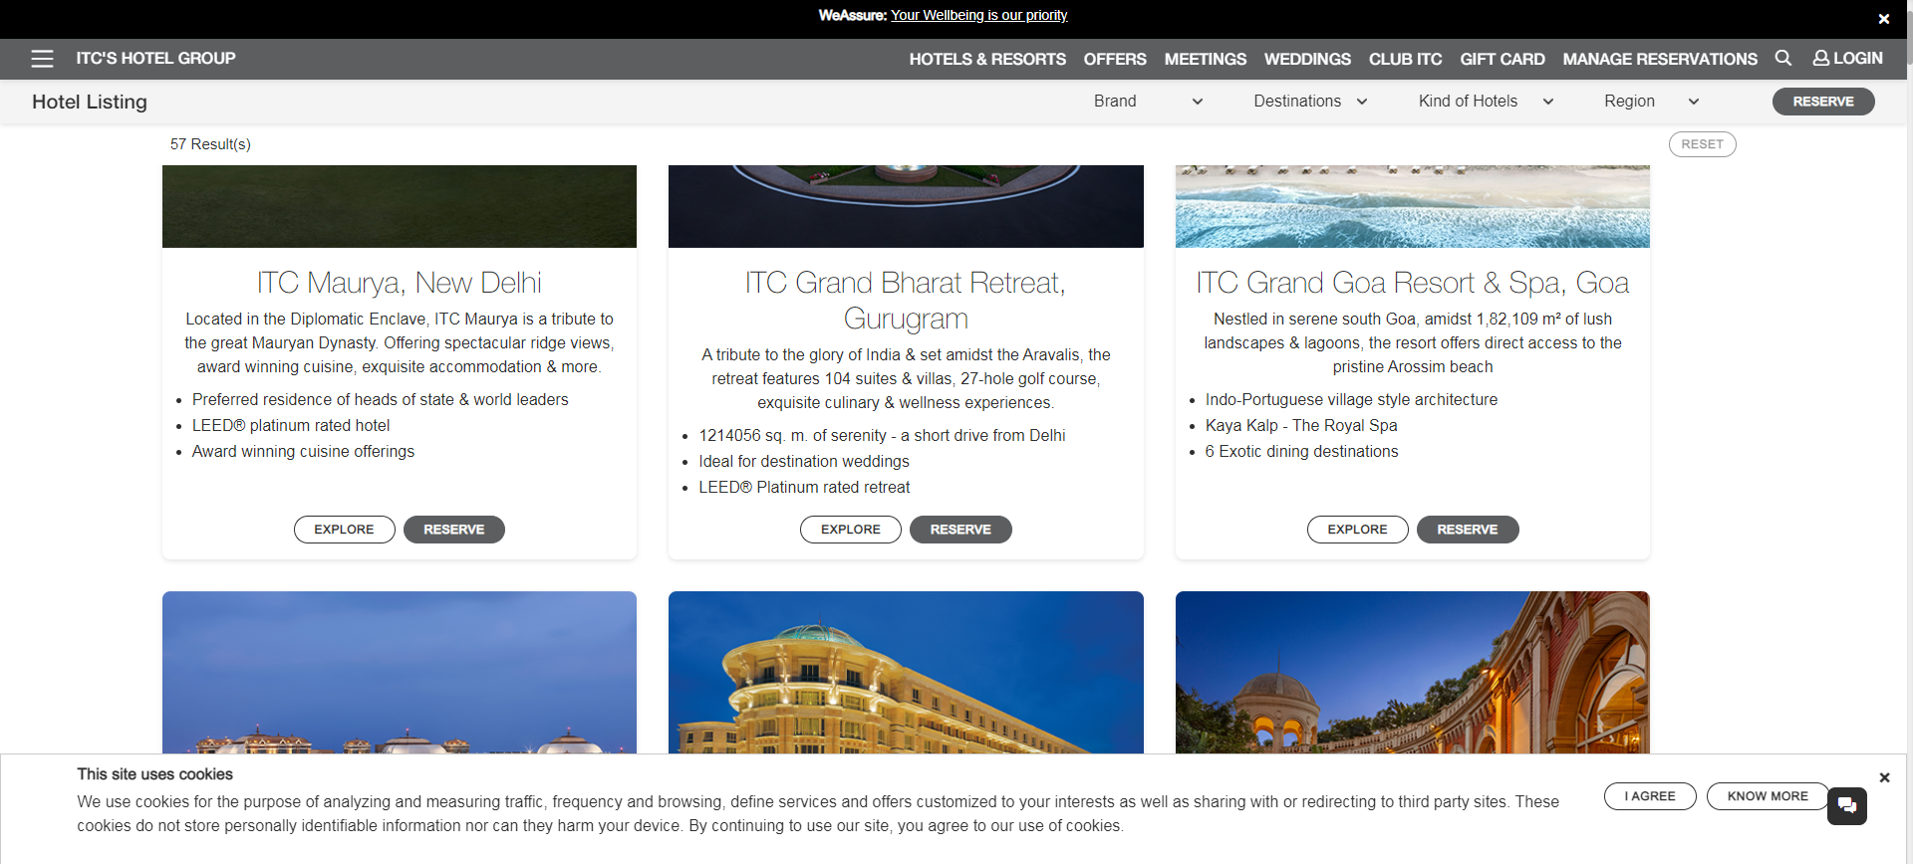



Hotel lists page

Slide 3
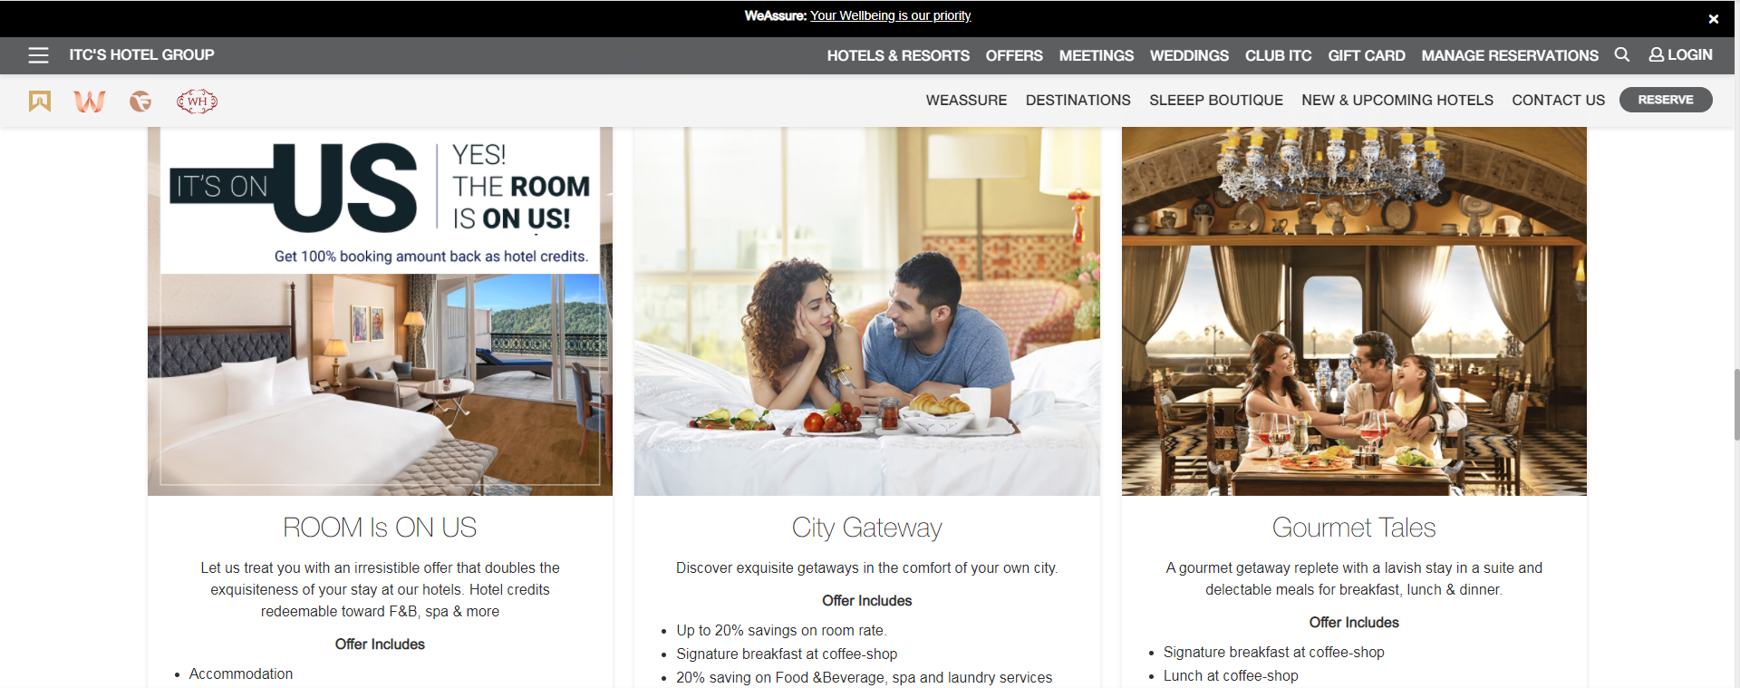
Display features in home page like this
Features to add:
1 Wedding & other ceremony
2 meetings & banquets
3 holiday special
4 first trip after marriage

Slide 4
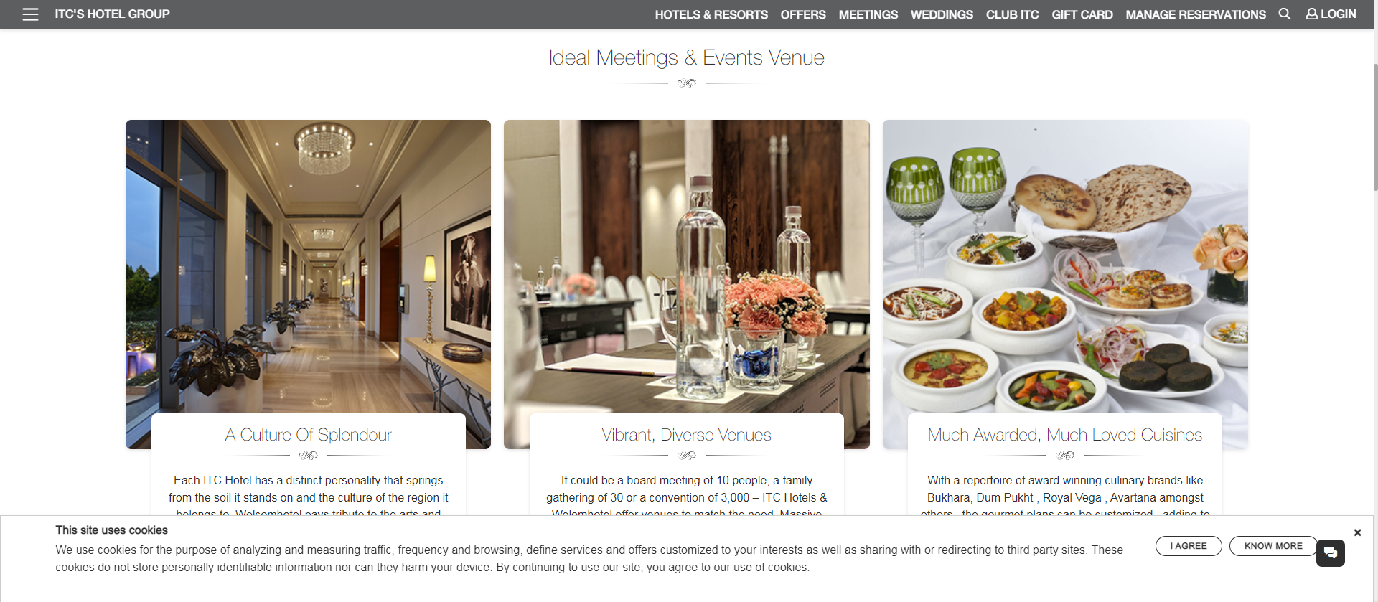
Meetings Page1: Packages Overview

Slide 5
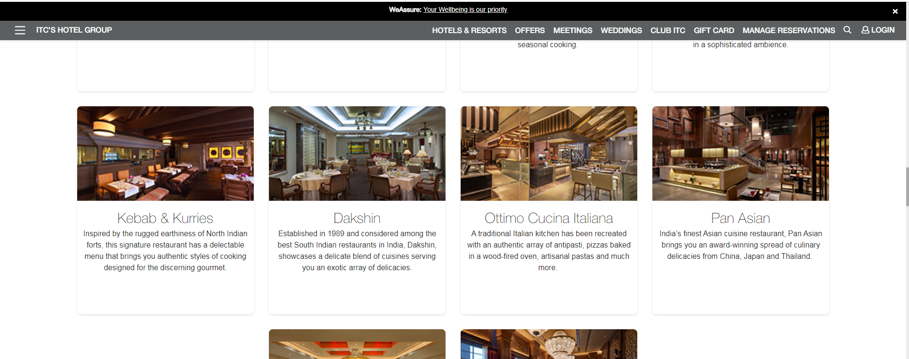
Meetings page2: Features

Slide 6
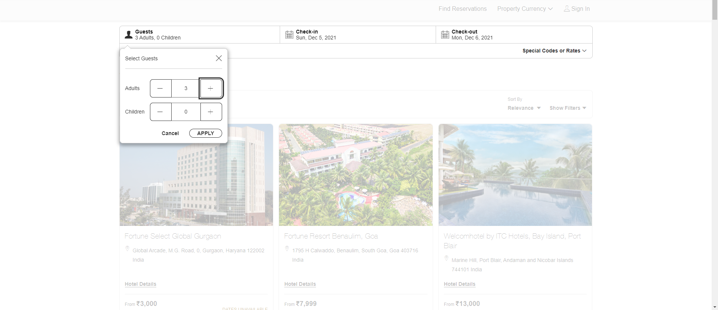
Booking Page Display after user login

Slide 7
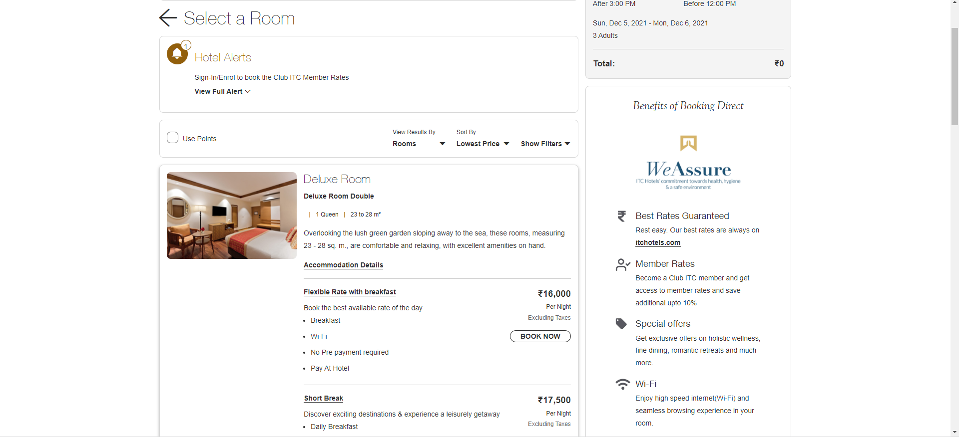
Display Packages like this before booking

Slide 8
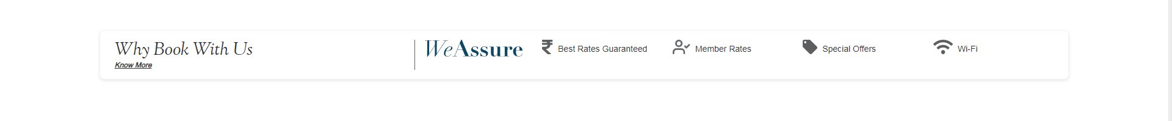
Display common packages in home page like this

Slide 9
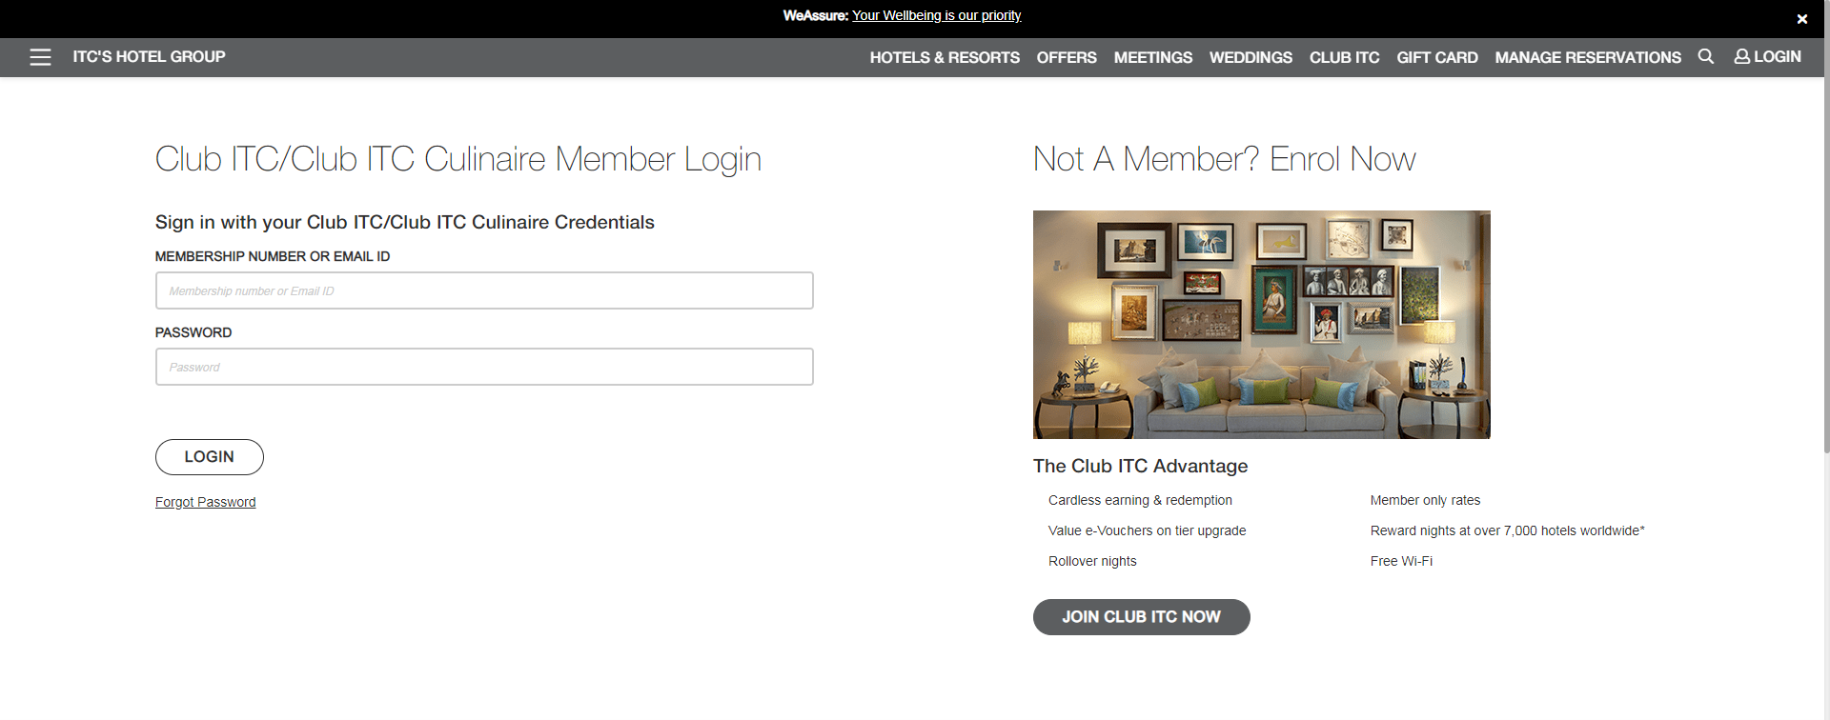
Login Page
Make this a Carousel image

Slide 10
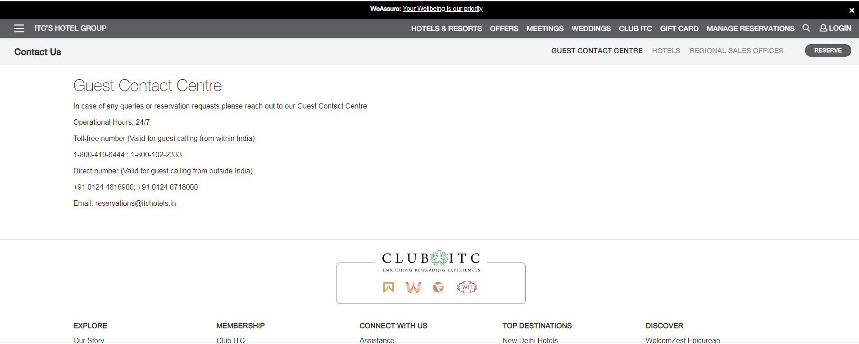
About Us page
SHOW CAROUSEL HERE

Slide 11
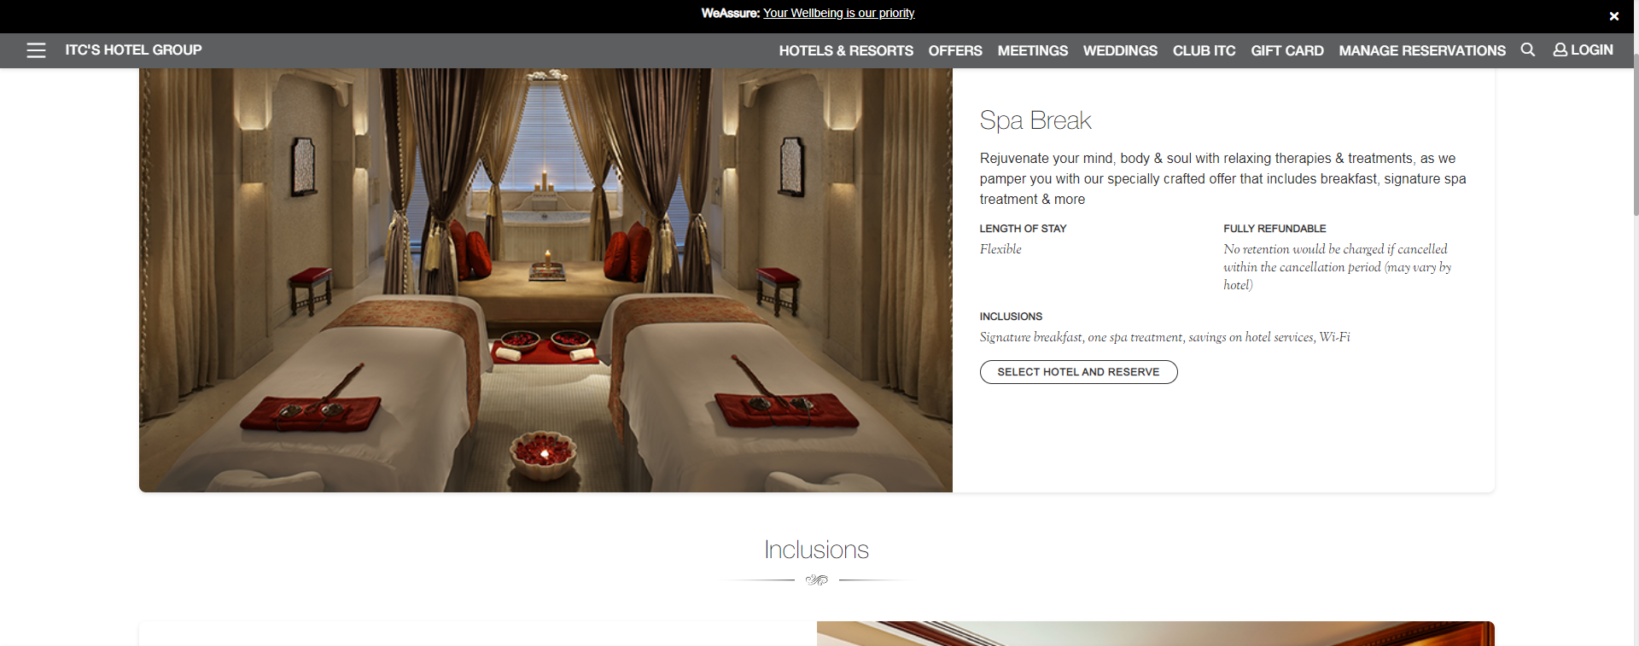
SPA Page 1 overview, features, packages

Slide 12
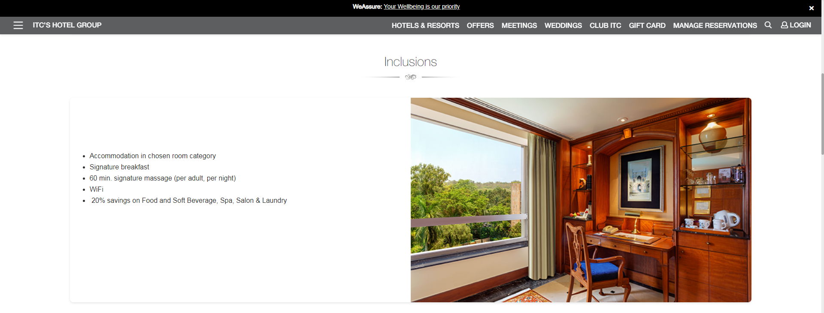
Spa page 1 continuation

Slide 13
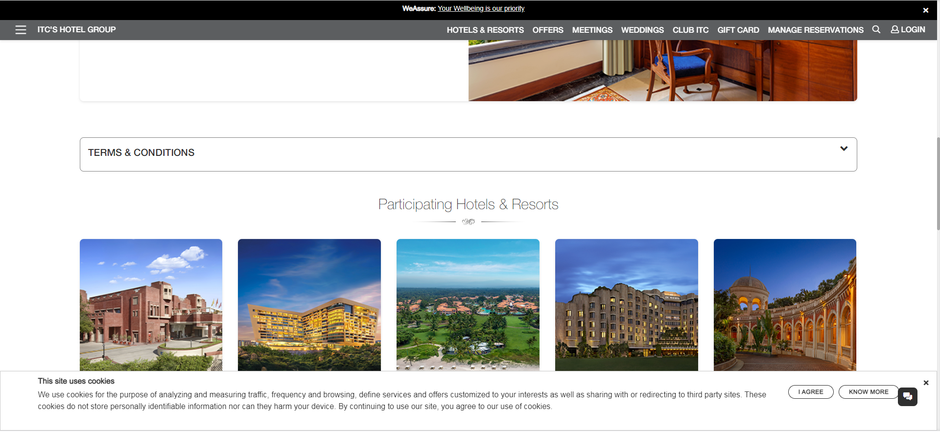
SPA page 2, participating hotels

